Slide 1

Air Quality Index Prediction
Shridatta Patil

Slide 2
Objective:
Development of a predictive regressor model to find air quality index of a specific area. The model requires different parameters which includes PM2.5, PM10, NO etc. We're trying to forecast the value of a continuous variable with the Air Quality dataset.
Benefits:
This model can be used to determine the air quality index instantly and can be used to help government organizations, agencies.

Slide 3
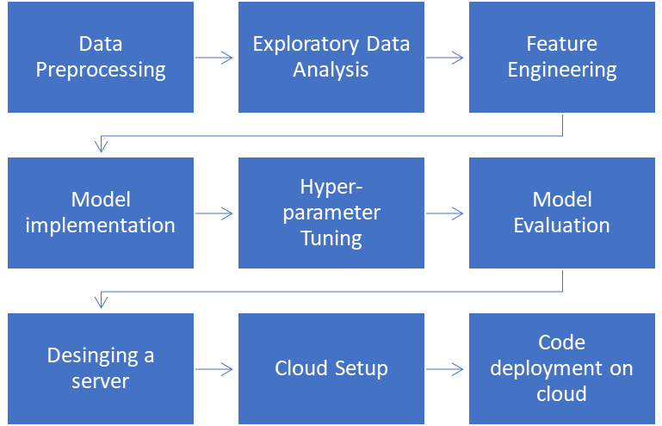
Architecture
Data Preparation
Model development
Deployment

Slide 4
Data validation and transformation
dAta type | Null values | Numerical columns
Data type of columns is given in the schema file. It is validated when we insert the files into Database. | If any of the columns in a file have all the values as NULL or missing, we can fill it by some methods. | All the numerical features were standardized using Standard Scaler, preventing any data leakage.
If data type is wrong, we can convert it using pandas library. | We can fill them by using mode, of categorical columns or mean and median of numerical columns. | This process is done in pipeline for numerical features for the convenience of deployment.

Slide 5
Data Insertion
Insertion of files in the table - All the data is uploaded into a file named “city.csv”.

Slide 6
Model Training
1. The data in file is imported to Jupyter notebook by using pandas.
2. In data preprocessing step, data is checked if there missing data, duplicate values, and datatypes of each feature. In our dataset, there are null values and are handled .
3. After analysis of features, relationships between variables is analyzed using pair plot. Distribution of numerical values is plotted to see to what extent our data is skewed .
4. After train and test splitting, Standard Scaler was fitted to several models.

Slide 7
Model Selection:
Having trained several models and obtained R2 scores, it was determined that Random Forest Regressor performs better than other models. Grid Search and Cross Validation is used then to optimize our model.
Prediction
The model is made in such a way to maximize the accuracy and also other performance metrics so that the predictions are as accurate as possible
The average accuracy after cross validation

Slide 8
Q&A
What is the sourse of data? | What was the type of data? | What is the complete flow you followed in this project? | How are logs managed?
The data for training is provided by the client in the form answers to certain questions asked . User has to enter answers for those questions. | The data is the combination of both numerical and categorical values. | Refer to 3rd slide for the process flow. | Following s are the logs that we are using : Data Insertion log, Model Fitting log, prediction log, etc.

Slide 9
What techniques were you using for data pre-processing?
Removing unwanted attributes
Visualizing relation of independent variables with each other and output variables
Checking and changing Distribution of continuous values
Cleaning data and imputing if null values are present.
Scaling the data

Slide 10
How training was done or what models were used?
First, we started with data cleaning, EDA and feature engineering.
Then ambiguities were removed from the data. Numerical columns was scaled using Standard Scaler.
Random Forest Regressor model was used as the best estimator which was then used for production followed by hyperparameter tuning.

Slide 11
How was prediction done?
Some questions were asked to the user like date, time of day, weather condition, numeric percentage of cloud cover, and the temperature of weather and these responses are taken as inputs which are then feed to the model as a single test case and the traffic volume prediction are then returned on the screen after a few seconds in which the data pipeline processes the input data to get the output.
What are the different stages of deployment?
When the pipeline is ready, we connected the front-end made on Anvil with the backend code having the pipeline on the local machine via anvil uplink.
A server is created in Flask which just displays a single web page and runs the uplink code via threading thereby creating a server.
The Flask page was then deployed to heroku cloud.
A cron job was set on the heroku platform to load the flask app every 30 minutes to keep the uplink connected and running the uplink code forever.

